Slide 1
Ohio University Interior Architecture School of Art+Design College of Fine Arts
Studio Based Design Education
What Is A Design Studio?
A Place Where Designing Happens!
Fall 2018

Slide 2
Welcome to a typical large college classroom. Do you find this to be an energizing environment?

Slide 3
Is this a visually engaging place?

Slide 4
Does this make you want to explore your own creativity?

Slide 5
At least they have Herman Miller ‘Caper’ chairs here.

Slide 6
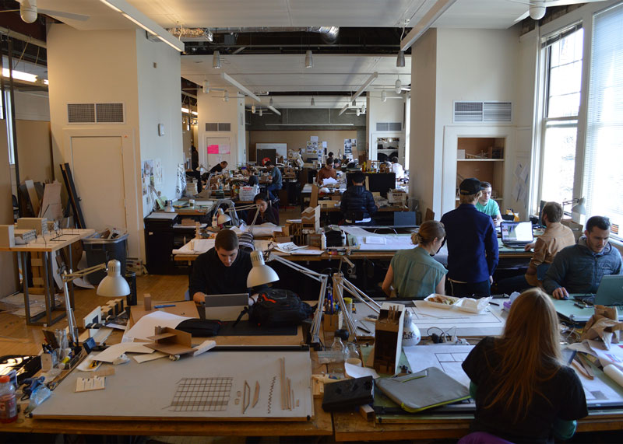
A Design Studio Space A Traditional Classroom Everyone Is A Teacher One Teacher Many Proposals (not answers!) One correct answer Creativity is essential and encouraged Creativity may not be needed

Slide 7
A design studio is an environment with a diversified and fluid hierarchy in which multiple proposals rather than ‘answers’ are sought out. Correct vs incorrect is not the main issue in a studio. A creative exploration is a central element of this environment.

Slide 8
A design studio provides students with a place of their own; a place to go when you want to explore a particular way of working and a way of thinking, called designing!

Slide 9
A typical classroom is an environment with a strict hierarchy and a singular answer to many, if not most, questions. A creative exploration is not necessarily an element of this environment.

Slide 10
A typical classroom is not a personal, dedicated, place. You cannot keep your stuff here!

Slide 11
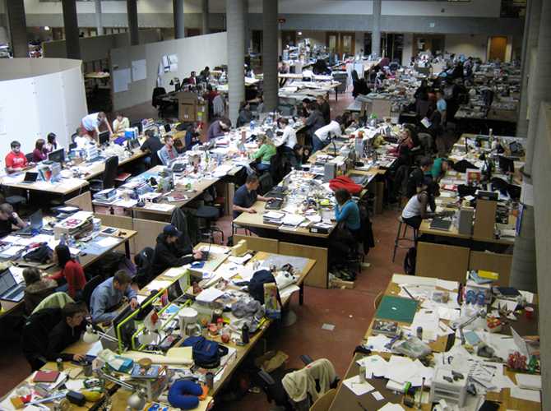
A design studio is a place to discover and ’learn’ by making things. You can keep lots of your things here!

Slide 12
A design studio space has the process, the event, of ‘critique’ built into it. A teacher moves around the studio for the purpose of ‘critiquing’ the design explorations of the students. This process is a core element of a design education.

Slide 13
‘Critique’ can take many forms. A thoughtful discussion between student and teacher is a critique. A challenge by the teacher to the student to do more, or better, is a critique. A proposal by the student to explore a different point of view is a critique.

Slide 14
Studio spaces often contain formal critique spaces. A ‘formal’ critique may be a finishing point in a project, or a major decision making point.

Slide 15
‘Presentation’ is a central element in design education. A presentation of your own work is a moment to value, honor, and celebrate the advances students make as they acquire knowledge, skills, and professional attitudes.

Slide 16
Studio spaces and the equipment in them need to be valued and treated with care. Do not damage your own environment or equipment.

Slide 17
‘Making’ is how we learn as designing people. If you do not make what you are thinking about, you cannot really say it exists. Making can take many forms: a sketch, a physical model, a digital model, a prototype, a full size mock up.

Slide 18
You create yourself as a designing person through your repeated, immersive experiences in studio.

Slide 20
Your place in studio should reflect your interests and your personality as a designing person.

Slide 21
Thoughts and ideas are expressed visually

Slide 22
Learning by doing is at the heart of design school.

Slide 25
The studio place is an expression of action, energy, and dedication

Slide 36
Interior Architecture is a major in which
making things
(the active, engaged, physical process of making drawings, models, statements, objects, spaces)
defines who you are
(as a designing person, having ideas, knowledge, beliefs, desires, points of view)
and
how well you are doing
(as a design student,
working to expand your horizons, develop skills, and discover new points of view

Slide 37
What is required to become 'good' as a designing person?
Enthusiasm
Dedication
Production
Enthusiasm that you have, within yourself, and enthusiasm that you express to those around you.
Dedication that you bring to your work: you have to believe in the value of what you are pursuing
in this
major, in this work.
Production of actual, visible, presentable, design work.

